Slide 1
Parenting a School Age Child
Creating good habits that lead to
school success

Slide 2
Info for Parents:)
Lake Forest Hills Elementary
School Counselor
Shari Hooper, B.S. Elem Ed., M.Ed. Counseling
Contact Information
Phone: (803) 336-5004
hoopesh@boe.richmond.k12.ga.us
Original Presentation: Lianna Mikesina, Ostego Elementary

Slide 3
Parenting a school age child: 5 Parent Tips
Always be positive about school.
Establish good habits.
Help your child recognize the importance of being kind.
Monitor your child’s use of technology.
Never be afraid to ask for help.

Slide 4
#1 – Always be Positive About School
“Eagerness to learn is at least as important as knowing specific facts and skills.”
(from the National Association for the Education of Young Children)

Slide 5
Be Positive About School
Put your own negative experiences aside
Don’t lie about your negative experiences, but minimize them to stress the importance of doing well in school, saying things like, “I wish I had…”
Be sure your child realizes he/she is doing something important and doesn’t take school for granted
It is not a chore
It is leading us to a lifetime of success
Notes:
When parents say things like, I hated math too… we give our children a reason not to do well, and this does not help them find success. Any negative experiences we had, we definitely want to turn into positives for our children.
Don’t say things like: You have to go to school because “it is the law”. Try to encourage your child to think of school as an opportunity to have a happy successful life in a line of work they will enjoy. That is always our goal in education.

Slide 6
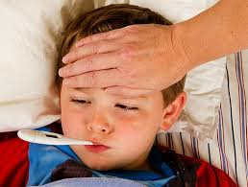
Be Positive About School
Attendance is important!
Children should stay home when they are seriously ill, but sniffles, coughs, headaches, and minor stomachaches should not keep them at home.
When we miss a lot of school we minimize its importance.
Notes:
Many ailments are there for a short while and then gone. If you’re not certain how serious an ache or ailment is, see how your child is acting when you let them stay at home. If their behaviors are normal – take them to school or find a way to get them to school. This will help avoid the “I just want to stay home syndrome.”

Slide 7
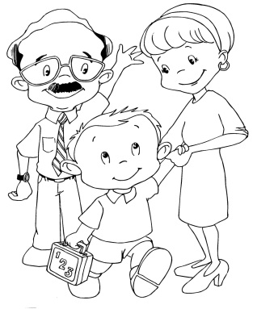
Be Positive About School
Accept your child as the learner they are and don’t put unrealistic expectations onto them or expect less than they are capable of.
Each child should feel successful when they do their best. We are at school to learn skills – not earn grades. Praise your child for learning each new skill.
Encourage participation at school.

Slide 8
Be Positive About School
If your child shares something with you about something another student said or did, about a comment the teacher made, about anything at school or on the bus that has upset him, don’t react in front of your child – but reassure him. Let him know you care and will look into this situation further. Then please contact the administration or the school counselor.

Slide 9
Be Positive About School
If you find your child developing a negative attitude about school or about coming to school, contact us immediately, so we can work with you to help turn this back into a positive place for your child to come.

Slide 10
#2 Establish Good Habits
The habits your child starts in kindergarten, will likely be the ones he/she will follow for the next 13 years. Let’s make them good ones!

Slide 11
Establish Good Habits
Routines are very helpful (although not always easy to follow)
Bedtime should be at the same time nightly and should allow a minimum of 10 hours of sleep on school nights.
Teach good hygiene: brushing teeth every morning and evening, bathing or showering regularly, washing hands after using the restroom…

Slide 12
Establish Good Habits
READ TOGETHER NIGHTLY! There is nothing that has been shown to be more of a predictor of good readers than this.
Homework should be a nightly routine (10 minutes per night per grade level)
Make the time the controller of when they get to play, not whether they are finished. This will encourage students to take time to do their best.

Slide 13
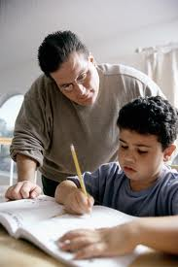
Homework
The purpose of homework is to practice skills students learn in school. Practice is an important part of learning. It takes 17 times of practicing a skill before it moves from our short term memory to our long term memory.
This is why our most teachers ask that you do some homework daily, rather than all in one night. It gives your child more chances to practice.

Slide 14
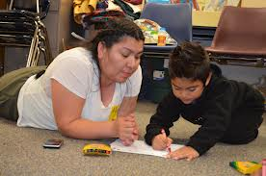
Homework
A routine time to do homework each night is usually best (right after school is often not the best time, especially for active children)
Choose a quiet, distraction free environment
5-7 year olds should work for no longer than 15 minutes without a break

Slide 15
Homework
Teach your child INDEPENDENCE!
Homework is your child’s responsibility to complete. Your responsibility is to see that they sit down to do it. If they refuse, give a consequence and send the work back to school with a note.
If you do their work for them now, you will be doing it for the next 13 years. When parents give too much help, the result is often that kids want to take ALL of their work home rather than do it at school.

Slide 16
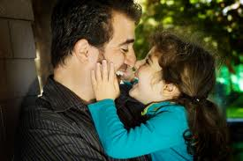
Establish Good Habits
Try to make morning routines as stress free and argument free as possible
Lay out clothing to wear the night before
Have the book bag filled and ready to walk out the door the night before
Set an alarm to allow for plenty of time to get ready
Send your child off to school with a smile and a hug!

Slide 17
#3 Help your child recognize the importance of being kind!
Too often we react with anger and the result is a lot of angry, unhappy people.
The best reaction is actually a smile and a kind word in most instances. When a child does not get the intended outcome (to make the other mad) they often walk away.

Slide 18
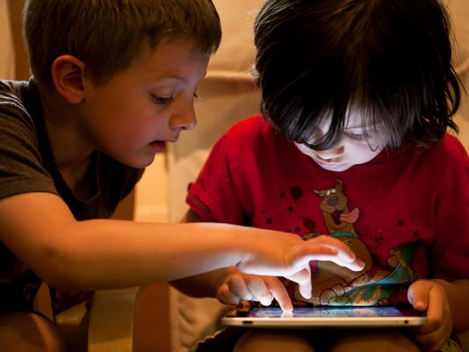
#4 Monitor your child’s use of technology
Technology is everywhere, and kids sometimes kids are better at it than we are.
There are advantages to technology, even in school, but children still need to be monitored when using technology.
Limit the use of television, video games, social connections on the computer, and cell phones. Kids still need to play creatively and not have their minds constantly bombarded by outside sources.

Slide 19
#5 Never be afraid to ask for help
No one has the answers, but we can rely on each other when we are lost, frustrated, or think we’ve tried everything.
We need you to be on our team and we would like to be on your team.
Two heads are better than one, and we want our students to learn that they can rely on others. The best way to do that is to show them by example.

Slide 20
The end?
Of course not! This is just the beginning. Let’s make it a great one – together!

